Slide 1
Restaurant Recommendation for Groups
DIGITAL AND ALGORITHMIC MARKETING
BUSN 37304-85
WINTER 2020
LI LIU
SURESH GOVINDARAJ
XI ZHAO

Slide 2



Preferences Differ (1/2)
I want Chinese Food
I’m in the mood for a Burger
Something close please. I’m starving
Graphics credits: Freepik
Notes:
Each member of a dining party has different preferences. Each of these preferences have different severity (how important is a preference?). To recommend a good restaurant for the whole party to enjoy, it is important that we maximize the utility of the group and not the individual

Slide 3

Preferences Differ (2/2)
Casual kid-friendly place
Healthy option for the family
Pasta time!!!
Pizza?
Graphics credits: macrovector/Freepik
Notes:
Family members have each their own preferences and it is usually a tough choice to decide on a good restaurant that works for them.

Slide 4
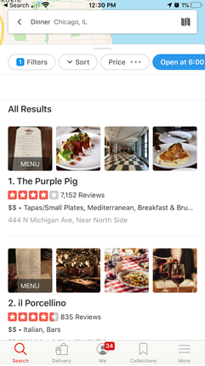
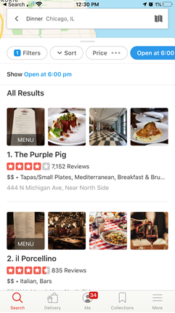
Missing Feature: Recommendations for Groups
Group Mode
Family Mode
Group Mode
takes preferences of all users in the dining party to make recommendations.
Option to link other users to aggregate preferences
Family Mode takes preferences of all members in the user profile
Notes:
One of the limitations of current restaurant search in platforms like Yelp is lack of support for mulit-user preferences like the examples before. We are proposing a group mode which lets an user add other users as part of the search to include their preferences in the search process. Family mode is similar to Group Mode but the kid’s preferences are taken from the parent user profile instead of connecting to a different user’s profile

Slide 5

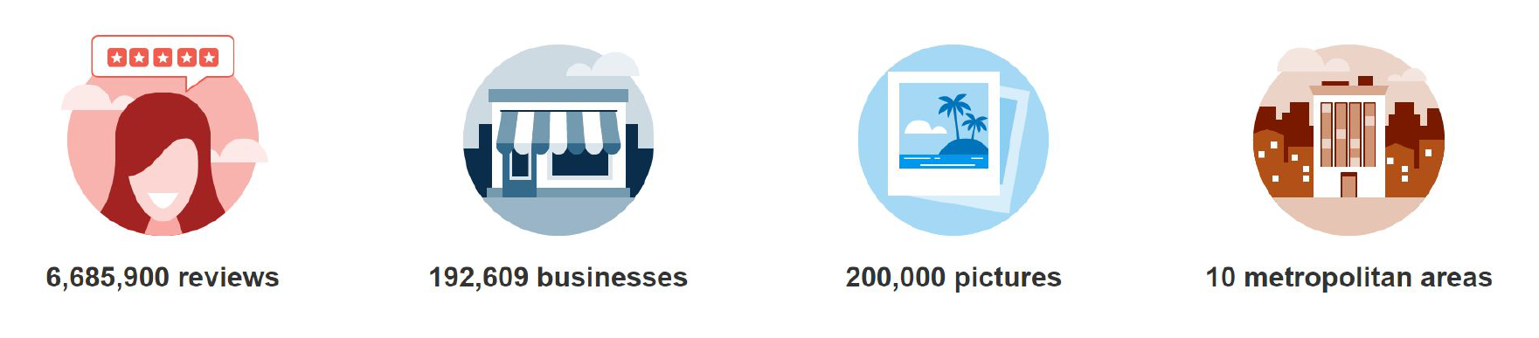
Data
Source: Yelp Daraset Challenge (Round 13)
Size: 6 GB in JSON format
For simplicity,
focusing on restaurants in Las Vegas and most recent reviews
Data source: https://www.yelp.com/dataset

Slide 6
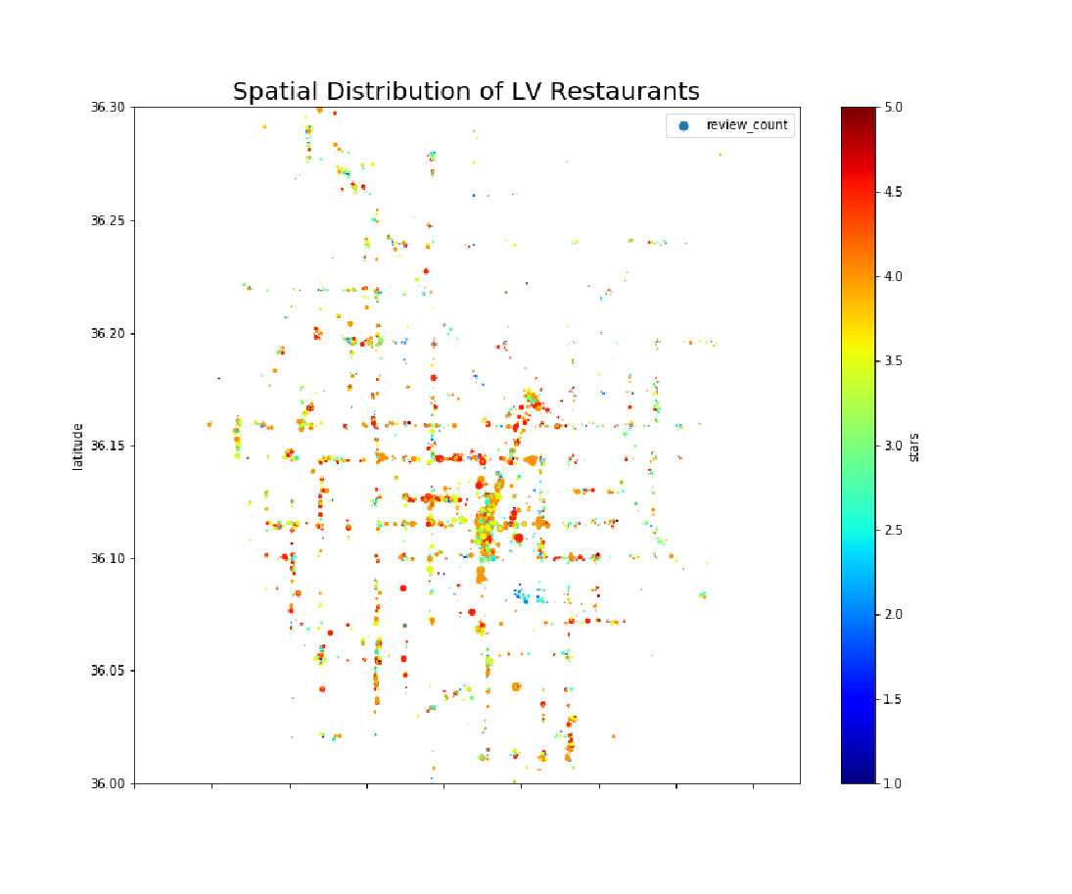
Las Vegas Restaurant Spatial Distribution
Dot color: review ratings
Dot size: review counts

Slide 7
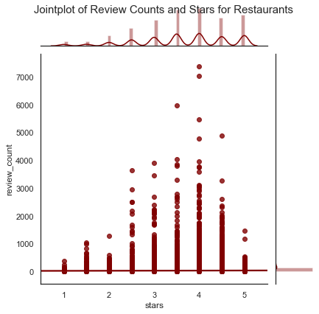
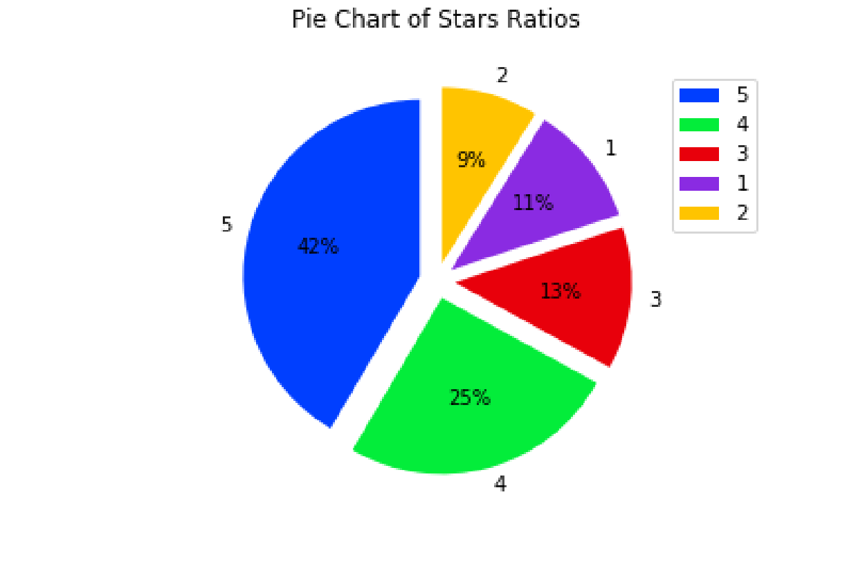
Visualizing Restaurants’ Rating

Slide 8
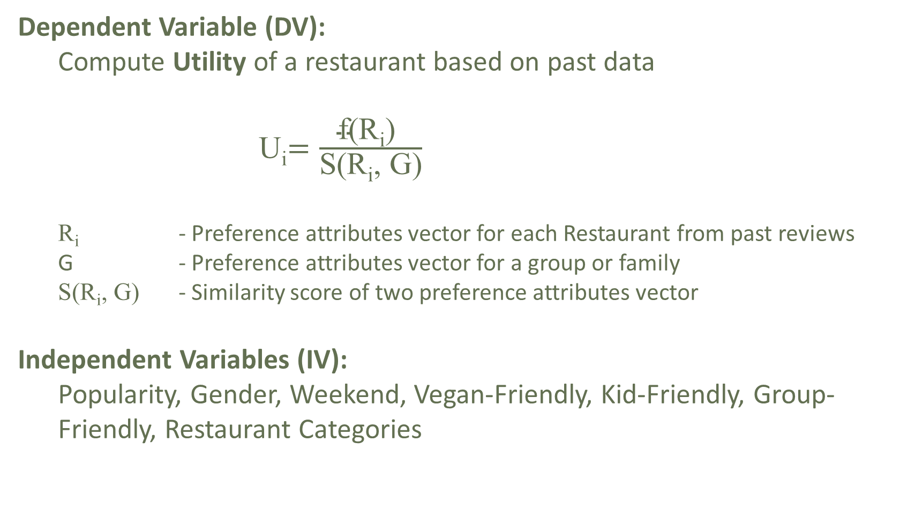
Model
Notes:
To build the preference-based recommendation system for Groups, we will build a machine learning model that computes the utility of each restaurant based on its past data. We extract the seven independent variables (IV) described above from the review data after performing several manipulations described in the following section.

Slide 9
IV 1: Popularity
Customers might prefer to choose popular restaurants
Popularity = 1 if
If rating is greater than average rating
If there are enough reviews (at least 40% of average rating count per restaurant)

Slide 10
IV 2: Gender
Does restaurant utility depend on customer’s gender?
Detected from reviewer’s name (1 if female)
IV 3: Weekend
Suitable for weekend or work week?
Detected from reviews’ date (1 if written on weekend)
(Assuming date of review same as service date)

Slide 11
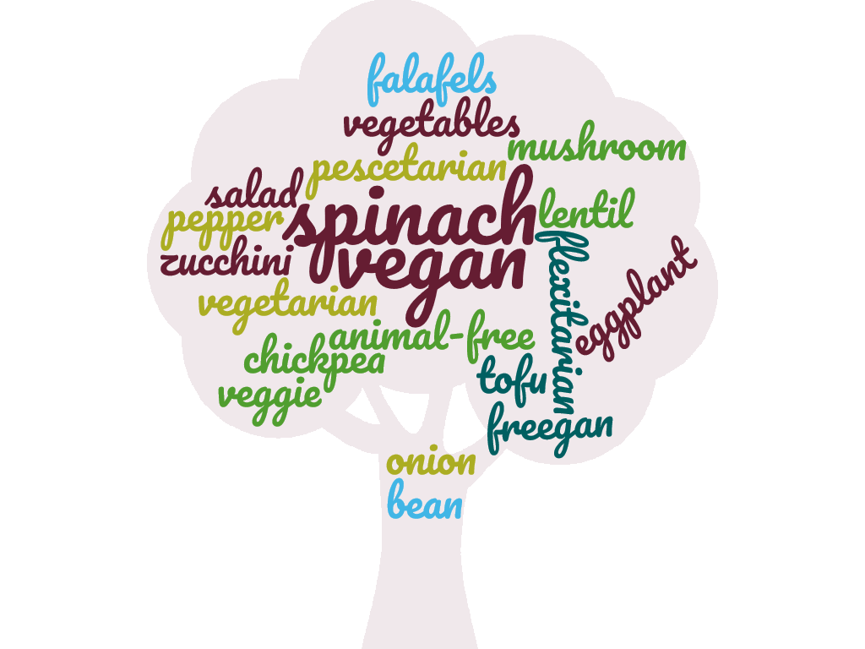
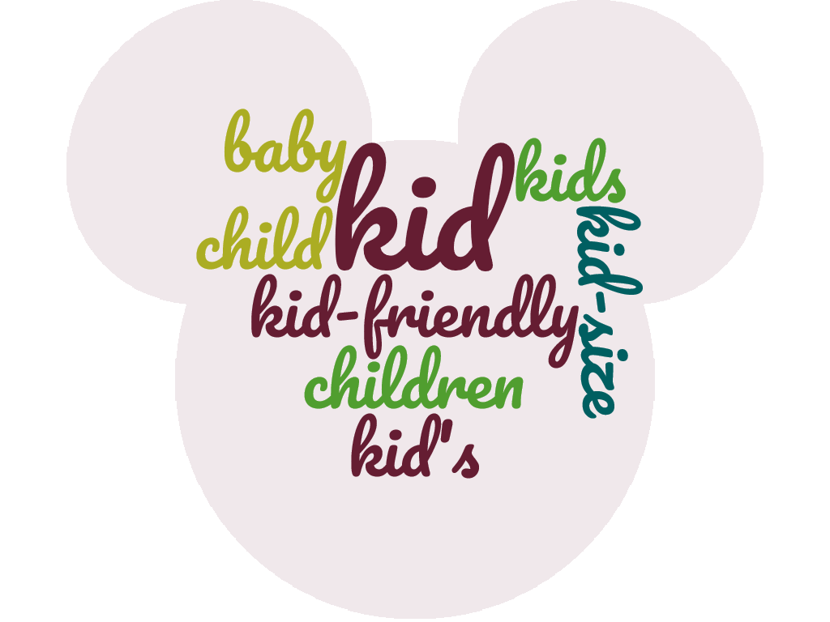
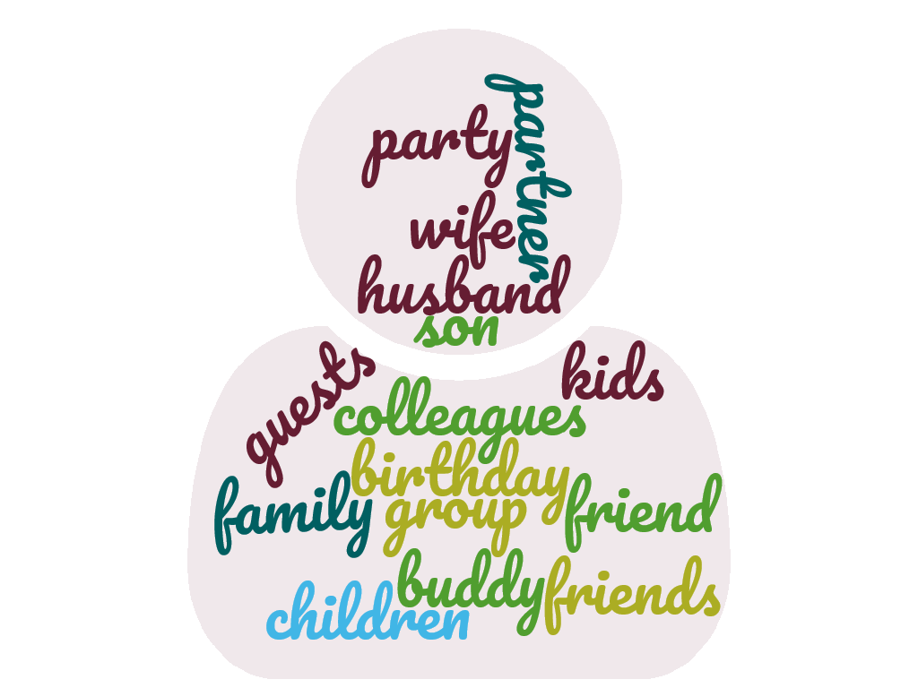
IV 4-6: Vegan-Friendly, Kid-Friendly, Group-Friendly
Text mining from review by scanning for related words
Vegan
Kid
Group
Notes:
To determine the above independent variables, we scan the reviews for each restaurant and look for the categorial words described the group. The word clouds show the word list used for each group

Slide 12
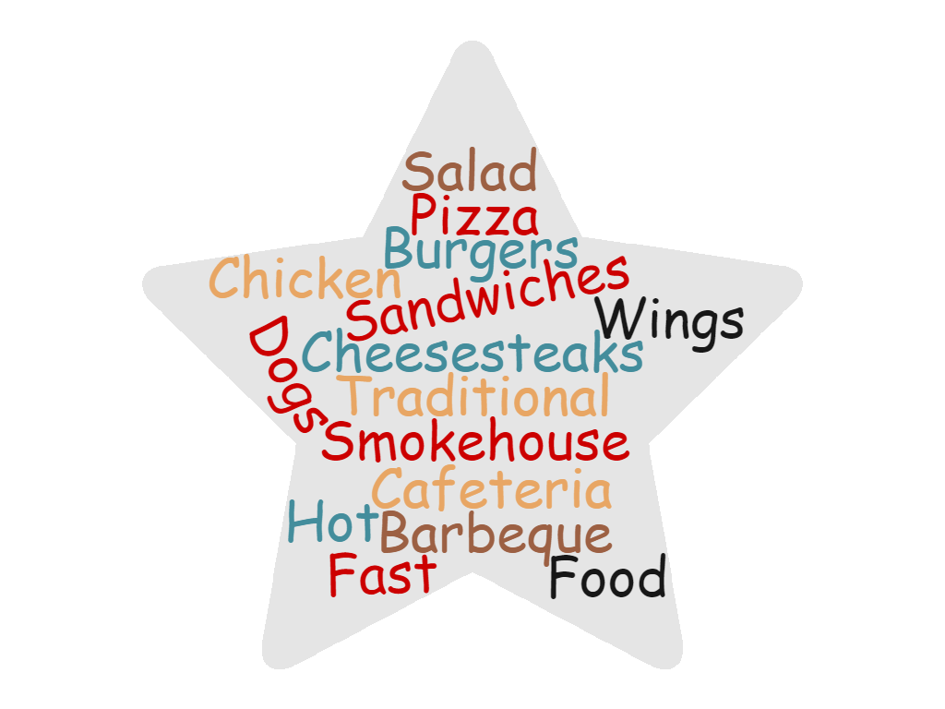
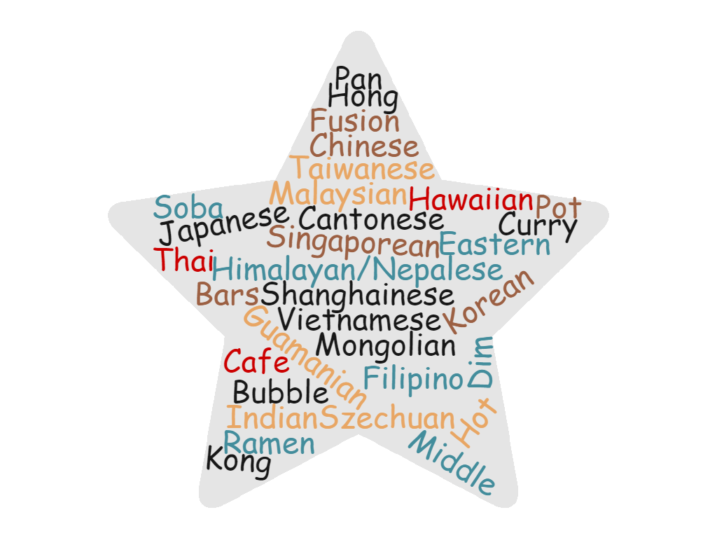
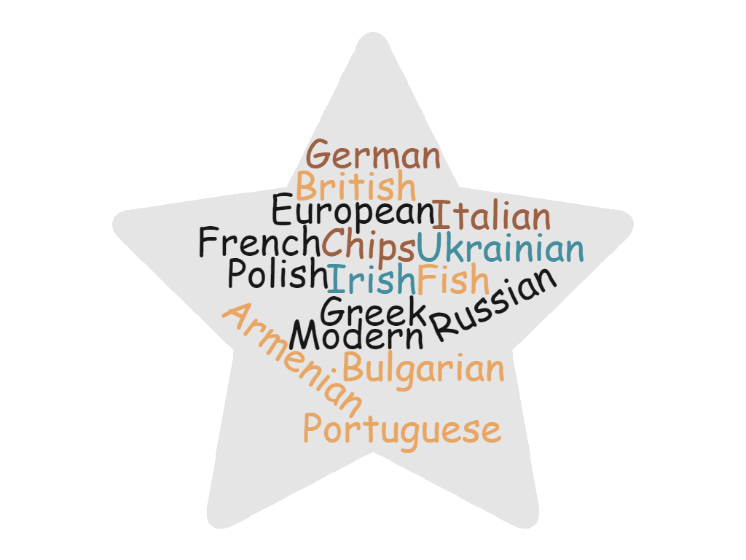

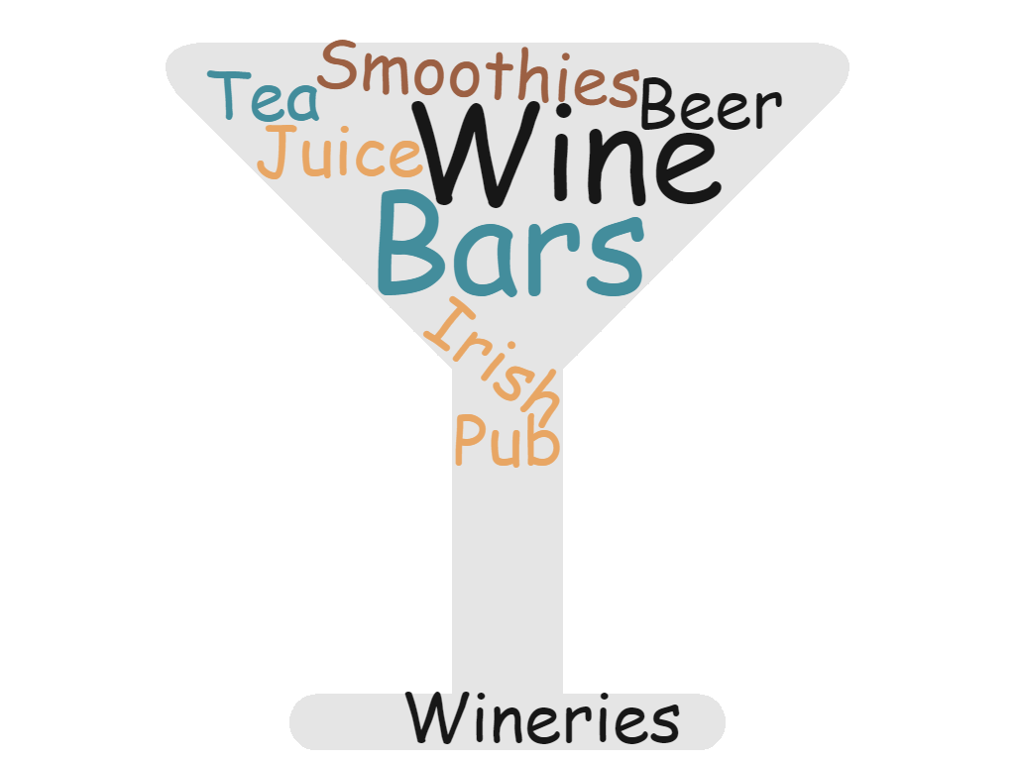
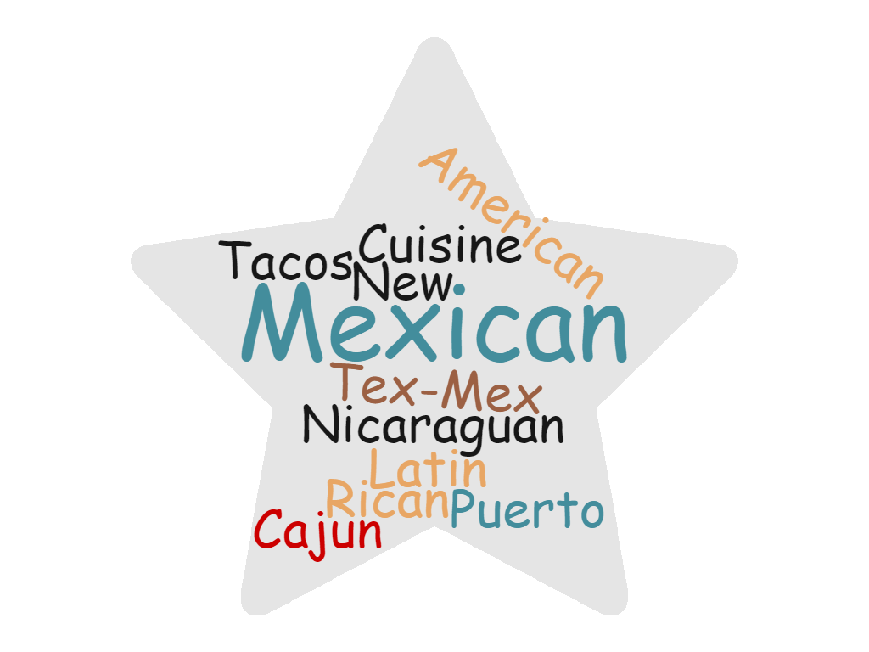
IV 7: Food Categories
American
Asian
European
Mediterranean
Drinks
South American

Slide 13
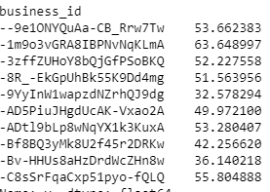
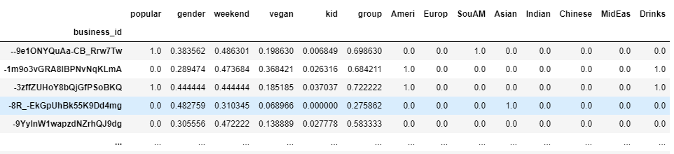
Finding f(R_{i})
X (3778*14)
f(R_{i}) by 8 machine learning algorithms
y (3778*1)

Slide 14
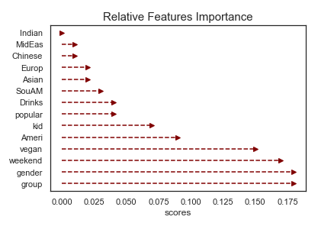
Relative Features Importance by Random Forest

Slide 15
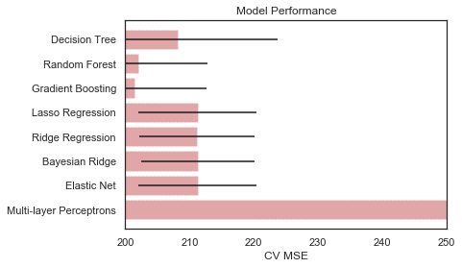
ML Model Comparison

Slide 16
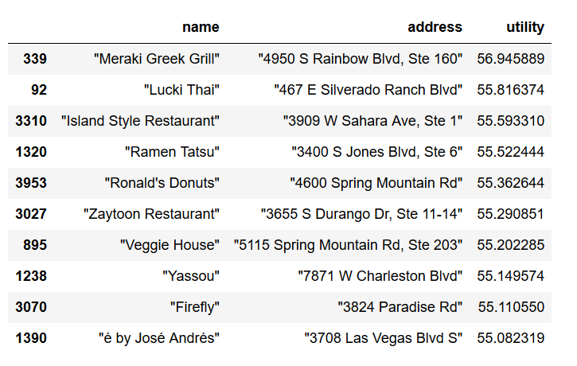
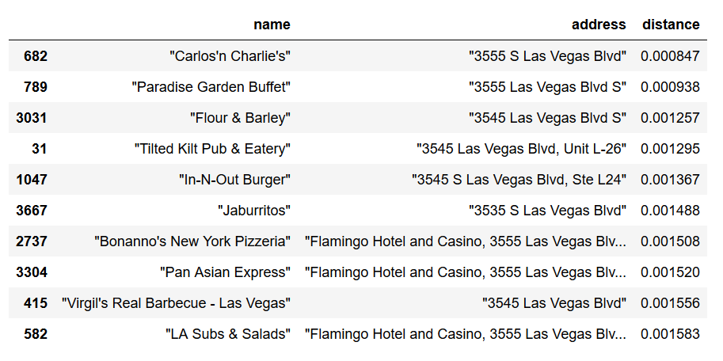
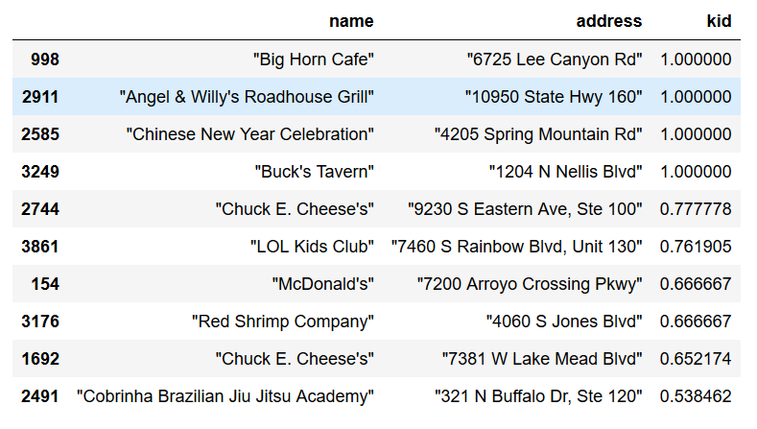
Model Output: No Group Preference
Default – Utility Based
Sort by Distance
Kid-Friendly Sort
* Search from Flamingo Hotel Las Vegas

Slide 17
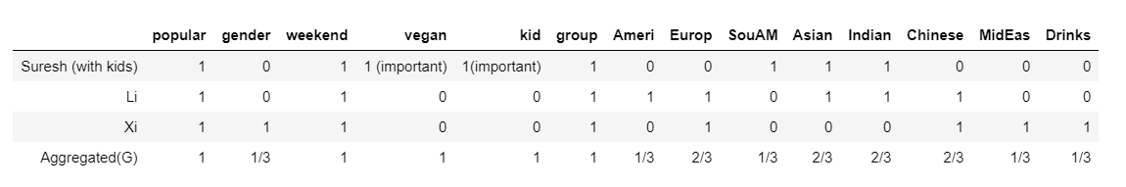
Sample User Case
Suresh: male, prefer South American & Indian & Asian food, vegan (important), prefer nearby restaurants
Suresh’s Kid: kid foods (very important)
Li: male, prefer American & Chinese & European & Indian & Asian food, non-vegan (not important), location first
Xi: female, prefer Chinese & South American & Middle East & Drink food, non-vegan (not important), plocation first

Slide 18

Similarity between R_{i} and G
S (R_{i}, G) = Euclidean distance
If the group’s preference attribute is G = <1, 0, 1, 0>,
they will be satisfied at restaurant with close attributes Ri = <0.7, 0.1, 0.9, 0.2> (S = 0.38)
they will be unsatisfied at restaurant with distant attributes Ri = <0.5, 0.9, 0.4, 0.3> (S = 1.23)
As a result, if S is small, U will increase; if S is large, U will decrease.

Slide 19
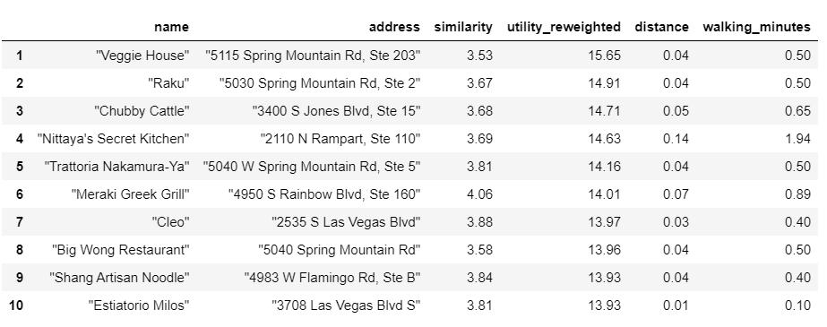
Model Output: With Group Preference

Slide 20




Next Steps
Explore other preference attributes
Implement the App support and Launch
Track Algo performance from real-time user feedback and tweak preference weights
Expand to other cities

Slide 21
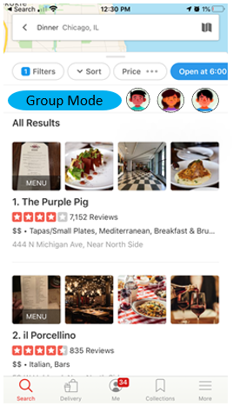
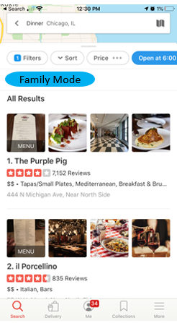
Conclusion
Proposed Group Mode and Family Mode to consider multiple user preferences to suggest restaurant recommendations
Developed and implemented a utility theory-based ML model

